Slide 1
ASP.NET MVC CORE
Instructor: Edwin oduor

Slide 2

Quote of the day

Slide 3
Lesson objectives
Relationships – One to One

Slide 4
Lesson pre-requisites
In order to take full advantage of this section you need to have the following;
Computer with Visual Studio Installed.
Stable Network Connection.

Slide 5
Training methods and extra readings
TRAINING METHODS FOR THIS LESSON
EXTRA READINGS
Lecturing Method – This is the main method of training to be adopted in this lesson with illustrations and practical coding examples.
Discussion Method - This method will be adopted periodically whereby learning will be derived principally from the students brainstorming together, rather than from the trainer. Three main types of discussions will be used:
Directed discussion
Developmental discussion
Problem-Solving discussion
Home and Learn C#

Slide 6
Relationships –one to one

Slide 7
exercise

Slide 8
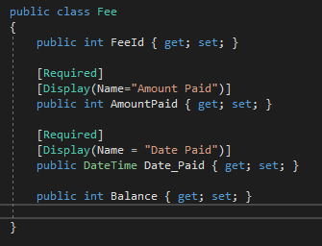
To create relationship one to one, will add a folder in the model give it the name Fees, inside the folder create a class call it Fee, the class should have the following properties.

Slide 9
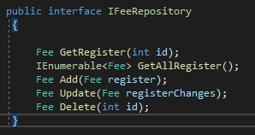
After the class is created, create an Interface give it the name IFeeRepository
Create another class give it the name FeeRepository it should implement the interface above.
After all that is done add a migration and give it an appropriate name then update the database.

Slide 10
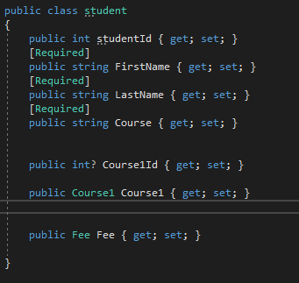
Next will now create a relationship between the tables, the relationship is between students and Fees table.
In the students class will add the last code, this is to show that we are relating the student with Fee.

Slide 11
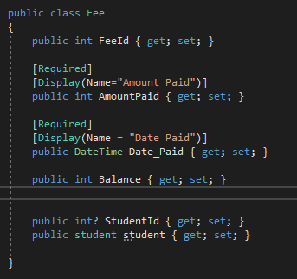
And in the Fee class will add a property studentId which is going to be a foreign key in the Fee table the other property is to show that we are relating Fee with student.

Slide 12
After all that is done add a migration and then update database so that whatever we did can be affected in the tables.

Slide 13
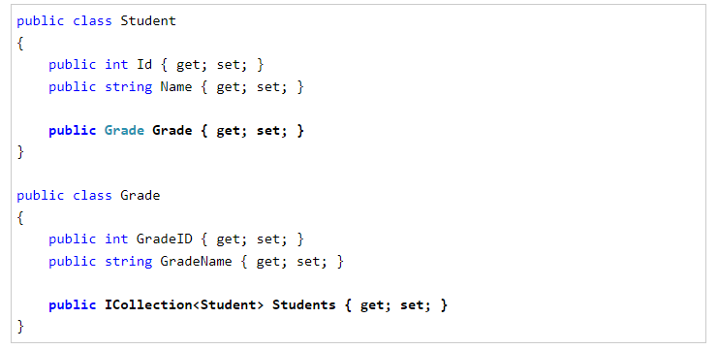
One to many relationships, then add a field that you want to be the foreign key in this case we can add studentId in the Grade class, just above public I collection.

